Slide 1
Domain Course BA Sociology: Life course, family & health 2018-2019 Week 1: Demographic change
Matthijs Kalmijn
Lonneke van den Berg
Department of Sociology

Slide 2
Course content
Demographic trends
Marriage, gender, and parenthood
Causes and consequences of divorce
Ageing and intergenerational relationships
Health inequalities and the life course
Social capital and health

Slide 3
What we will do
Lectures (60 minutes) plus Q & A
Readings (3-4 per week)
Writing (reading assignments)
Seminars: discussion of readings
Research/practice (in seminar)
Exam (readings, lectures, course encyclopedia)

Slide 4
(1) Family forms
Family as the descendants of a common ancestor (not per se in one household)
Family as the family members within a household (“gezin”)
Official Dutch definition of “gezin” is “elk leefverband van één of meer volwassenen die verantwoordelijkheid dragen voor de verzorging en opvoeding van één of meer kinderen” (Van der Avort et al. 1996: 5)

Slide 5
(1) Family forms
Two-parent family (‘nuclear family’)
Single-parent family
Stepfamily & blended family
Same-sex parent family
Polygamous family
Extended family
Communes etc.

Slide 6
(2) Household forms
“Eén of meer personen die samen een woonruimte bewonen en zichzelf niet-bedrijfsmatig voorzien van de dagelijkse behoeften” (example of CBS definition)
Nearly everyone lives in a household
Not everyone lives in a family (gezin)

Slide 7
Households in the Netherlands

Slide 8
(3) Family functions (old & new)
Shelter
Consumption
Production
Socialization of the young
Schooling
Care of the old/sick
Social and emotional well-being
The family, the state, the market, or the community?

Slide 9
Children as ‘public goods’
Children have ‘public benefits’
Children have ‘private costs’
Children also have ‘private’ benefits

Slide 10
(4) Life course concept
Sequence of age-related transitions that people experience from birth to death
Domains: employment, family, housing
Occurrence, timing, sequencing and order of transitions
Early life course transitions affect later life courses

Slide 11
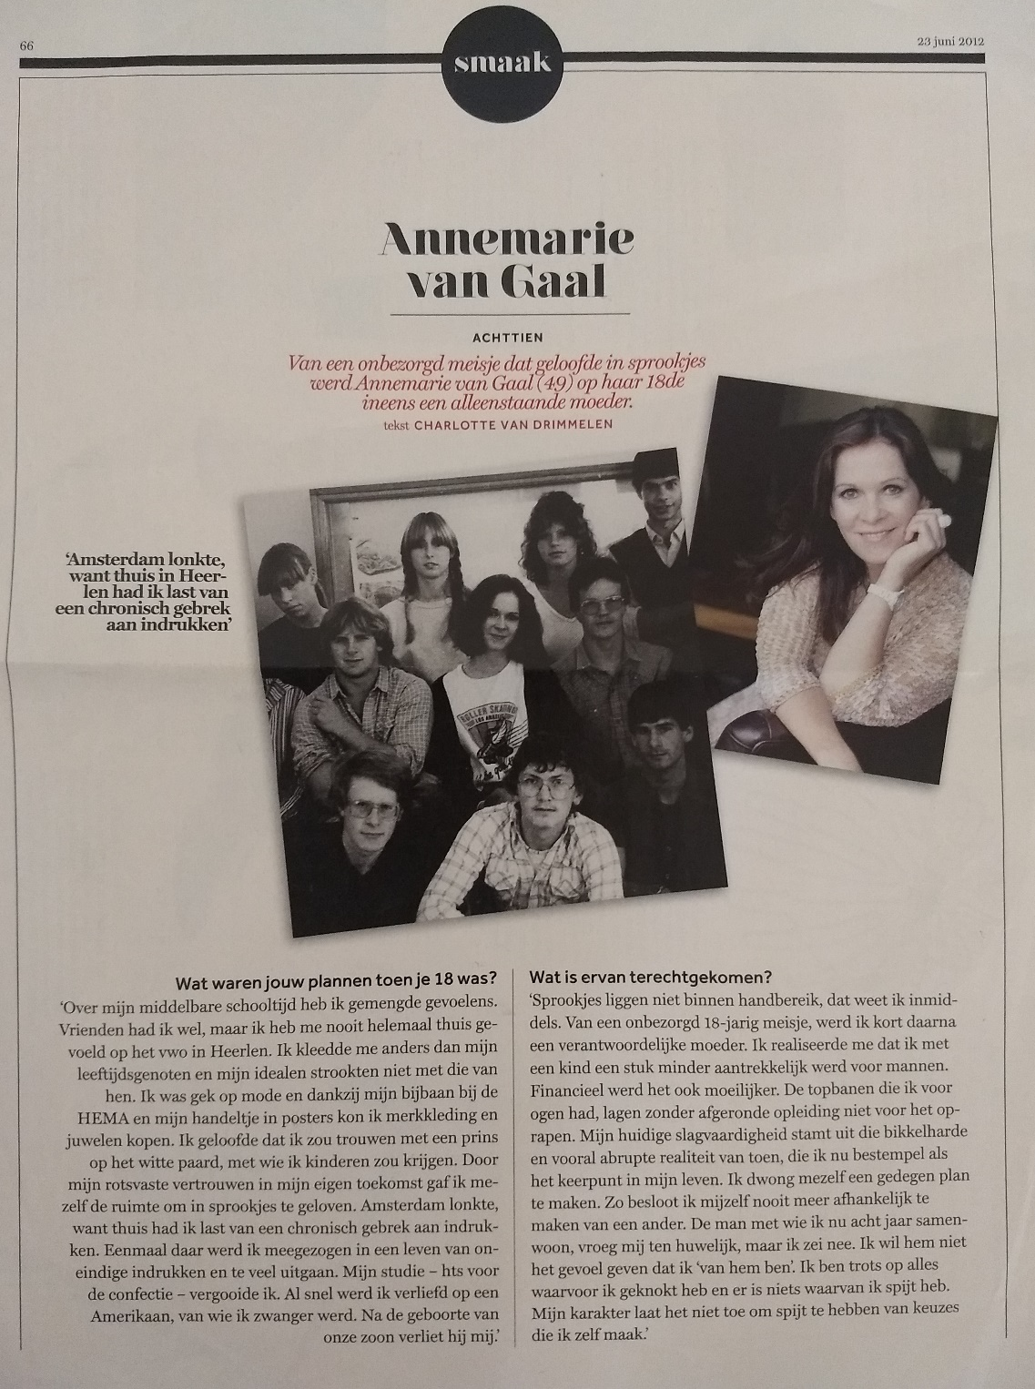
Path dependency

Slide 12
(5) Diversity in families/life courses
Class and educational differences
Ethnic and racial differences
Gender differences
Historical change
Societal differences

Slide 13
Migration and family structure
Source: Kalmijn, International Migration Review, 2016

Slide 14
(6) Fertility
Baby boom
Second Demographic Transition
First Demographic Transition

Slide 15
Demographic rates
Crude birth rate = # births in a year / # number of persons (divided by 1000)
Fertility rate = # births in a year / # number of women of childbearing age (divided by 1000)
Total fertility rate = number of children a hypothetical cohort of women expects to have given current age-specific birth rates
Replacement fertility = TFR of 2.1

Slide 16
(7) (First) Demographic Transition
1880 – 1930
Decline in fertility rate (& mortality rate)
Fertility declined via earlier stopping of fertility
Shift from very large to ‘normal’ family sizes
All western societies

Slide 17
(7) (First) Demographic Transition
Causes
Declining economic benefits of children
Increasing economic costs of children
Rationalization of fertility
Consequences
Shift from quantity to quality
“King child” era
Shift from “economic” to “emotional” ties to children

Slide 18
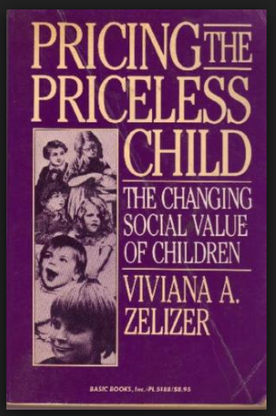
The value of children

Slide 19
(8) Second Demographic Transition
1960 – 1990
Further decline of fertility rate
Rise & then sharp decline in marriage rate
Increase in the divorce rate
Fertility declined via further declines within marriage AND via postponement of fertility
Shift to small family sizes & childlessness
Societies below replacement fertility (1.6, EU2017)

Slide 20
Parallel trends
1972
1964

Slide 21
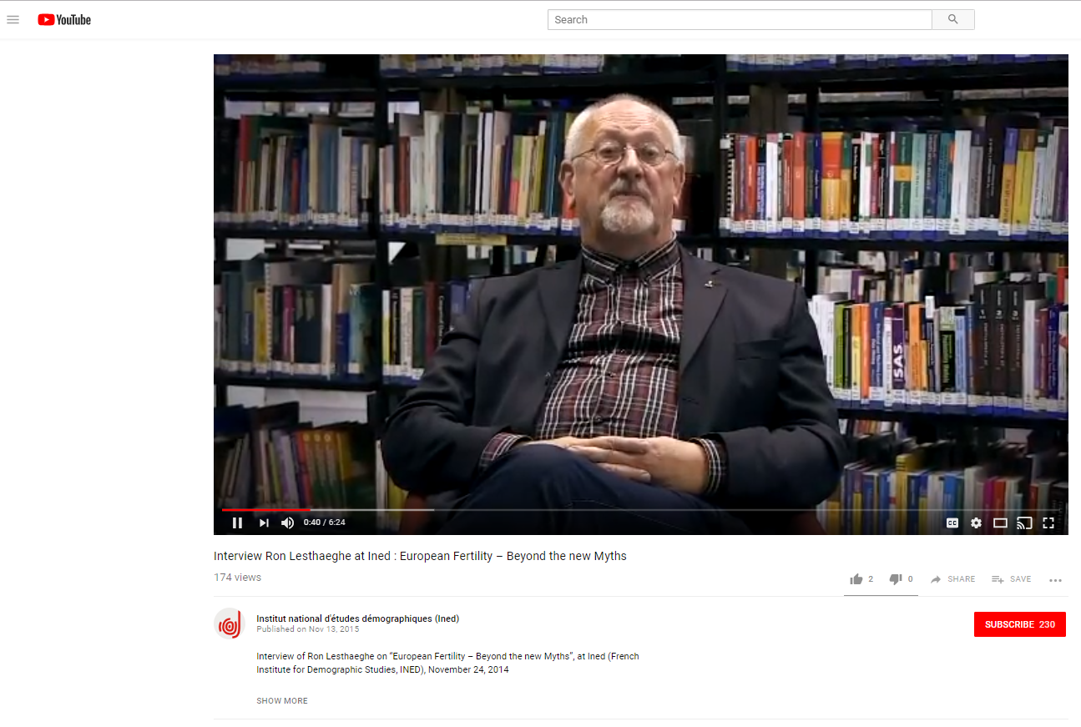
A European discovery

Slide 22
(8) How SDT changed the lifecourse
“From the standard life course to the choice biography”
Later marriages and later parenthood
Single living after leaving home & before marriage
Unmarried cohabitation(s) before marriage
More relationship dissolutions
Multiple unions per life course
More singlehood later in life

Slide 23
(9) Explanations of the SDT
Cultural causes
Structural causes
Secularization
Individualization
Gender egalitarianism
Increasing income and wealth
Increasing demand for women in LF
Educational expansion
Increasing economic uncertainty
Lesthaeghe & Van de Kaa
“SDT theory”
Others (Mills, Zaidi, Becker, Oppenheimer)

Slide 24
(9) Explanations of the SDT
Cultural causes
Structural causes
Emphasizes the primacy of ideals, norms, traditions, and values
Preference driven
Emphasizes the costs and benefits of choices
Norms and values are derivative
Constraint/opportunity driven

Slide 25
(10) The role of secularization
Church was influential in controlling marriage & fertility
Direct control
Indirect control via personal norms
Indirect control via social norms

Slide 26
Marriage norms
Own analysis of data from survey data Religion in Dutch Society 1985 (Felling et al.)

Slide 27
(11) The role of individualization
Changes in values rather than in norms
Values is what people think is important or valuable in life
Goals that have become more important:
Autonomy and privacy
Self-actualization
Gender equality
Marriage and family life would be less consistent with these new ideals

Slide 28
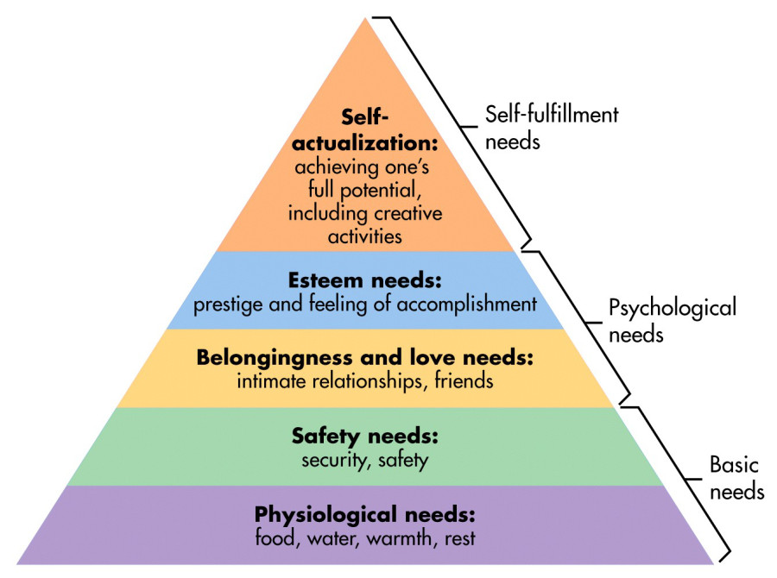
Maslow need hierarchy

Slide 29
(12) Rising income and wealth
Applies to first part of the trend
Post WWII growth in wages and incomes
Low unemployment levels
Easier to bear the financial cost of setting up an independent household
Resulted in earlier marriages
Potentially also in more children (Baby Boom)

Slide 30
Marriage in the 1970s

Slide 31
(13) Educational expansion
Rise of higher education
Closing gender gap in higher education
School enrolment is a hindrance to marriage and family formation
Cultural or structural force?
Explains postponement of life course transitions

Slide 32
Postponing relationships
Source: Statline Netherlands, own analyses, data based on birth cohorts.

Slide 33
(14) Rise of women in the LF
Demand for women’s LF → structural
Increasing ‘opportunity cost’ of children
Lower economic dependency on husband
Explains lower fertility
Explains lower marriage rate & higher divorce rate

Slide 34
Education, LFP, and fertility
Source: Statline Netherlands, own analyses, data 2003.

Slide 35
Education, LFP, and fertility
Source: CBS report, Wobma & Van Huis, 2012 (own graphs)

Slide 36
(15) Economic uncertainty
Globalization in context of prosperity (recent trend)
Flexibilization of the labor market
Marriage is long-term commitment
Requires some degree of certainty about future income and jobs
Leads to postponement of marriage and family formation
Leads to “flexible partnerships” (e.g., cohabitation)

Slide 37
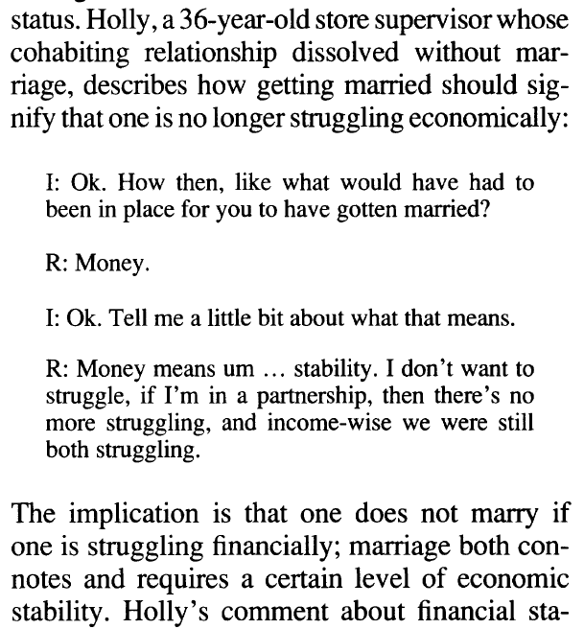
Money problems: the U.S. and Spain
Source: De La Rica & Iza in Review of Economics and the Household, 2005
Spanish youth unemployment rate is 34% (2018)
Source: Smock et al. Journal of Marriage and Family 2005

Slide 38
Recapitulation and questions

